Slide 1
Exact Logistic Regression
Epidemiology/Biostatistics VHM-812/802,
Winter 2016, Atlantic Vet. College, PEI
Raju Gautam

Slide 2
Purpose
Use with sparse data
  Why Ordinary logistic regression (OLS) may not be appropriate?
    Testing and inference is based on large sample size
    Normality assumption for parameter estimation
    Wald test follows normal distribution
    Likelihood Ratio Test (LRT) follows Chi-square distribution

Slide 3
Fisher’ exact test - overview
Similar to Chi-square, more accurate for small sample size
Example data: “lbw.dta” low birth weight data
  Effect of history of premature labour and smoking on low birth weight
Smoking
LBW
0
1
Conditional probability:
P(LBW+|smoking status) knowing that 4 out of 27 women are LBW+ and 2 out of 6 are smokers (smoke=1).
0
19 | 4
2 | 2
23
1
4
21
6
27

Slide 4
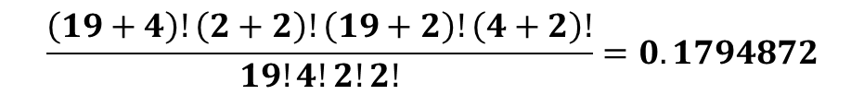
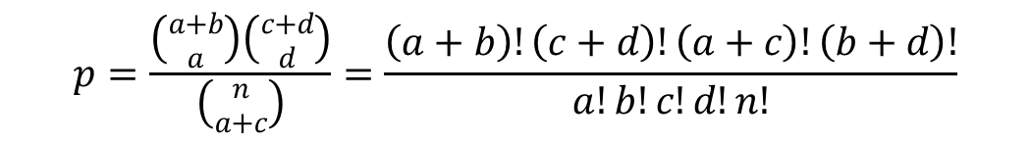
Exact probability
Given by hypergeometric distribution
Smoking
Smoking
0
1
LBW
 | 0 | 1 | Row total
0 | a | b | a+b
1 | c | d | c+d
C. total | a+c | b+d | a+b+c+d (=n)
0
19 | 4
2 | 2
23
LBW
1
4
21
6
27
$$p=\frac{\left({a+b \atop a}\right)\left({c+d \atop d}\right)}{\left({n \atop a+c}\right)}=\frac{\left(a+b\right)!\left(c+d\right)!\left(a+c\right)!\left(b+d\right)!}{a!b!c!d!n!}$$
$$\frac{\left(19+4\right)!\left(2+2\right)!\left(19+2\right)!\left(4+2\right)!}{19!4!2!2!}=0.1794872$$
Probability that women who smoked had babies with LBW

Slide 5
Example using STATA
hypergeometricp function
  hypergeometricp(N,K,n,k)
    N = sample size
    K = subjects with attribute of interest (eg. SMOKE = 1)
    N = subjects with outcome (event) of interest (eg LBW+)
    K = # of successes out of K
    di hypergeometricp(27,6,4,2)
    0.17948718

Slide 6
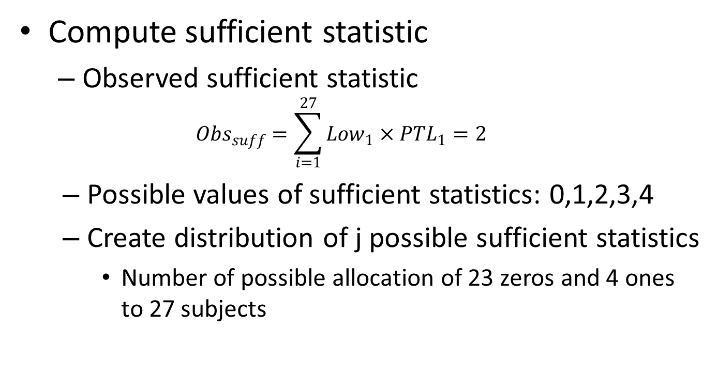
Computing P Value
Compute sufficient statistic
  Observed sufficient statistic
  $${Obs}_{suff}=\sum_{i=1}^{27}{{Low}_{1}×{PTL}_{1}=2}$$
  Possible values of sufficient statistics: 0,1,2,3,4
  Create distribution of j possible sufficient statistics
    Number of possible allocation of 23 zeros and 4 ones to 27 subjects

Slide 7
P value…
Suff. | Counts | Prob. H0 true
0 | 5985 | 0.341 | Pr. obs. 0 PTL+ and 4 PTL- in LBW+
1 | 7980 | 0.455 | Pr. obs. 1 PTL+ and 3 PTL- in LBW+
2 | 3150 | 0.179 | Pr. obs. 2 PTL+ and 2 PTL- in LBW+
3 | 420 | 0.024 | Pr. obs. 3 PTL+ and 1 PTL- in LBW+
4 | 15 | 0.001 | Pr. obs. 4 PTL+ and 0 PTL- in LBW+
Total | 17550 | 1
Test the hypothesis β₁ = 0
Calculate P value by summing the probabilities over values of the Suff. Statistic that are as likely or less likely to have smaller probability than the Obs_{suff}. = 2
P = 0.179+0.024+0.001 = 0.204

Slide 8
P value using STATA
. tab low ptl, exact
| History of premature
Low birth | labor
weight | None One | Total
-----------+----------------------+----------
0 | 19 4 | 23
1 | 2 2 | 4
-----------+----------------------+----------
Total | 21 6 | 27
Fisher's exact = 0.204
1-sided Fisher's exact = 0.204
Conclusion: There is not enough evidence to support that having a history of pre-term delivery increases the risk of low birth weight.

Slide 9
Exact logistic
Extends Fisher’s idea
  Computes estimates and confidence interval of each parameter separately
  Allows addition of covariates
  CMLE: Conditional Maximum Likelihood Estimates
  Uses computationally intensive algorithm

Slide 10
Exact logistic regression Number of obs = 27
Model score = 2.018634
Pr >= score = 0.2043
------------------------------------------------------------------
low | Odds Ratio Suff. 2*Pr(Suff.) [95% Conf. Interval]
----+-------------------------------------------------------------
ptl | 4.402267 2 0.4085 .2507705 79.01123
------------------------------------------------------------------
P value using 2*Pr(Suff.) is in error (Hosmer et.al. Applied Logistic Reg. 2013)
Compare with Ordinary Logistic Regression
. logistic low ptl
Logistic regression Number of obs = 27
LR chi2(1) = 1.81
Prob > chi2 = 0.1791
Log likelihood = -10.423421 Pseudo R2 = 0.0797
-----------------------------------------------------------------
low | Odds Ratio Std. Err. z P>|z| [95% Conf. Interval]
+----------------------------------------------------------------
ptl | 4.75 5.421312 1.37 0.172 .5072157 44.48304
_cons | .1052632 .0782518 -3.03 0.002 .0245188 .4519108
------------------------------------------------------------------

Slide 11
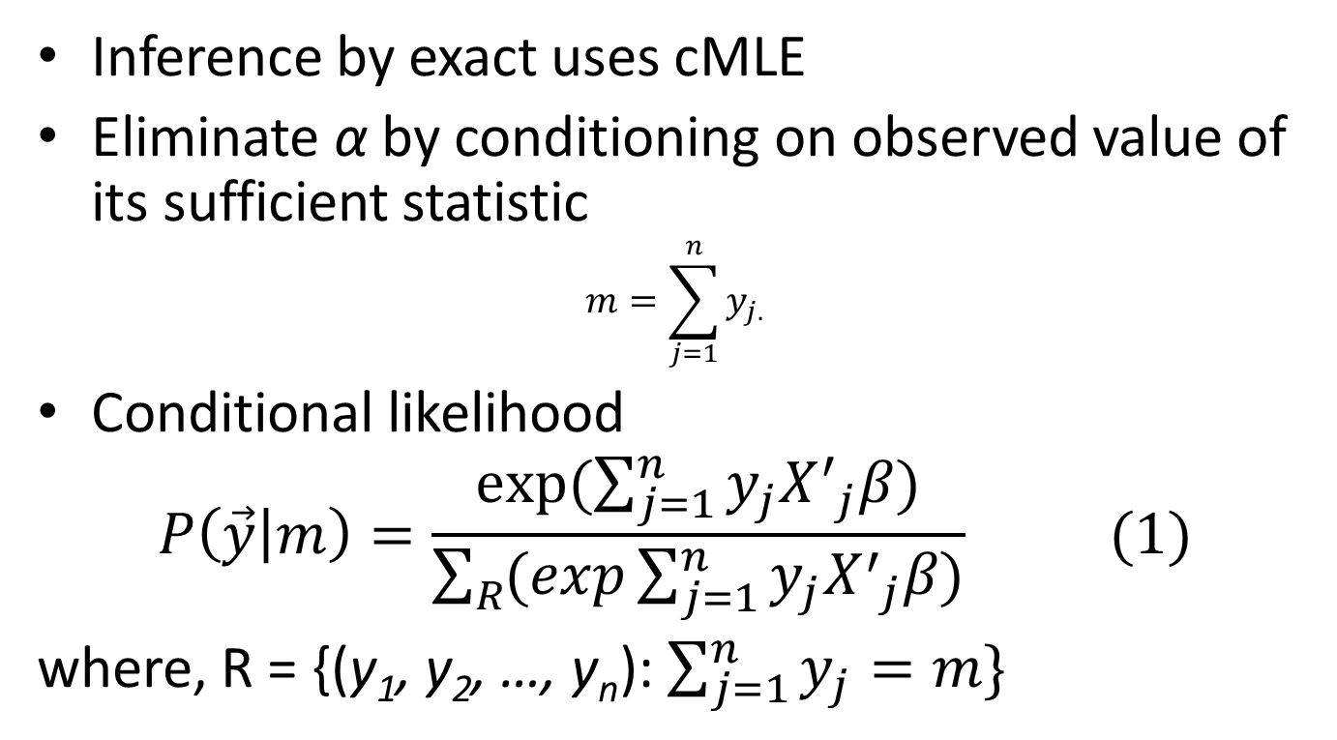
Why is the exact logistic OR different from OLR?
Inference by exact uses cMLE
Eliminate α by conditioning on observed value of its sufficient statistic
$$m=\sum_{j=1}^{n}{y_{j.}}$$
Conditional likelihood
$$P\left(\vec{y} | m\right)=\frac{exp⁡(\sum_{j=1}^{n}{y_{j}{X^{′}}_{j}^{}β)}}{\sum_{R}{(exp\sum_{j=1}^{n}{y_{j}{X^{′}}_{j}^{}β)}}} (1)$$
where, R = {(y₁, y₂, …, y_{n}): $\sum_{j=1}^{n}{y_{j}=m\}}$

Slide 12
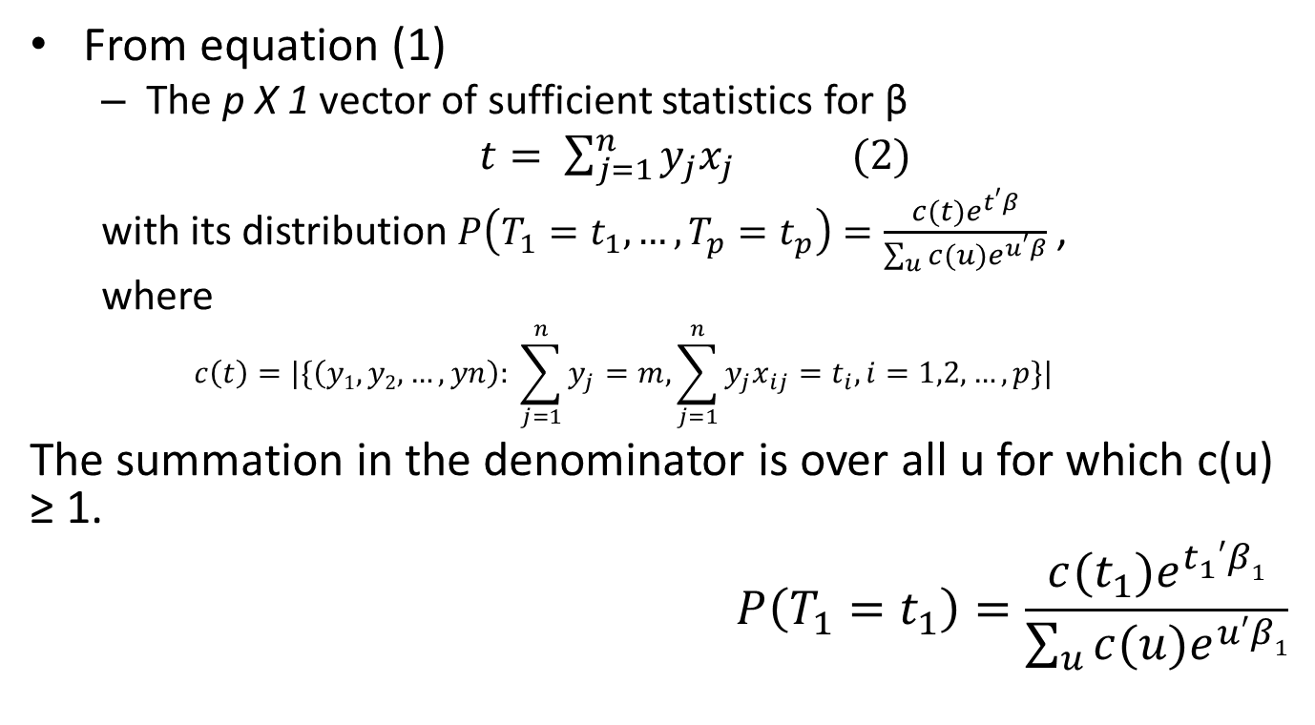
Why is the exact OR diff….
From equation (1)
  The p Х 1 vector of sufficient statistics for β
  $t= \sum_{j=1}^{n}{y_{j}x_{j} (2)}$
  with its distribution $P\left(T_{1}=t_{1}, …,T_{p}=t_{p}\right)=\frac{c(t)e^{t′β}}{\sum_{u}{c(u)e^{u′β}}}$ ,
  where
  $$c\left(t\right)=|\{\left(y1,y2,…,yn\right): \sum_{j=1}^{n}{y_{j}=m, \sum_{j=1}^{n}{y_{j}x_{ij}}=t_{i}, i=1,2,…,p}\}|$$
The summation in the denominator is over all u for which c(u) ≥ 1.
$$P\left(T_{1}=t_{1}\right)=\frac{c(t_{1})e^{t_{1}^{}′β1}}{\sum_{u}{c(u)e^{u′β1}}}$$
In our case, point estimate is estimated by maximizing

Slide 13
Robust Standard Errors
. logistic low ptl, robust
Logistic regression Number of obs = 27
Wald chi2(1) = 1.79
Prob > chi2 = 0.1803
Log pseudolikelihood = -10.423421 Pseudo R2 = 0.0797
------------------------------------------------------------------
| Robust
low | Odds Ratio Std. Err. z P>|z| [95% Conf. Interval]
-+----------------------------------------------------------------
ptl | 4.75 5.524584 1.34 0.180 .486056 46.41955
_cons | .1052632 .0797424 -2.97 0.003 .0238477 .4646294
------------------------------------------------------------------
Confidence interval wider
  Uncertainty due to small sample size

Slide 14
Zero count
Table containing cell with zero frequency
  Cross classify smoking status vs LBW
. tab low smoke, chi
| Smoking status during
Low birth | pregnancy
weight | no yes | Total
-----------+----------------------+----------
0 | 17 6 | 23
1 | 0 4 | 4
-----------+----------------------+----------
Total | 17 10 | 27
Pearson chi2(1) = 7.9826 Pr = 0.005
Suff_{obs} = Suff_{min} -> Lower limit = - Inf
Suff_{obs} = Suff_{max} -> Upper limit = + Inf

Slide 15
Median Unbiased Estimator
Exact logistic regression Number of obs = 27
Model score = 7.686957
Pr >= score = 0.0120
----------------------------------------------------------------
low | Odds Ratio Suff. 2*Pr(Suff.) [95% Conf. Interval]
--+-------------------------------------------------------------
smoke | 12.30305* 4 0.0239 1.361276 +Inf
-----------------------------------------------------------------
(*) median unbiased estimates (MUE)
In situations when Suff_{obs} = Suff_{min} OR Suff_{obs} = Suff_{max}
  Coefficient is estimated using MUE (Hirji et. Al. 1989)

Slide 16
An example from VER book
Data: Nocardia (Demonstration)
  Variables:
    casecont: case or control status of herd (outcome)
    dcpct: % of cows treated with dry-cow treatments
    dneo: use of neomycin
    dclox: use of cloxacillin
    dbarn: barn type (categorical variable)
  Predictor “dcpct” was included in the model but conditioned out

