Slide 1
Conditional Logistic Regression
Epidemiology/Biostats VHM812/802 Winter 2016, Atlantic Veterinary College, PEI
Raju Gautam

Slide 2
Purpose
Matched data (i.e Matched case-control design)
Eliminate nuisance parameters (i.e parameters we are not interested in)

Slide 3
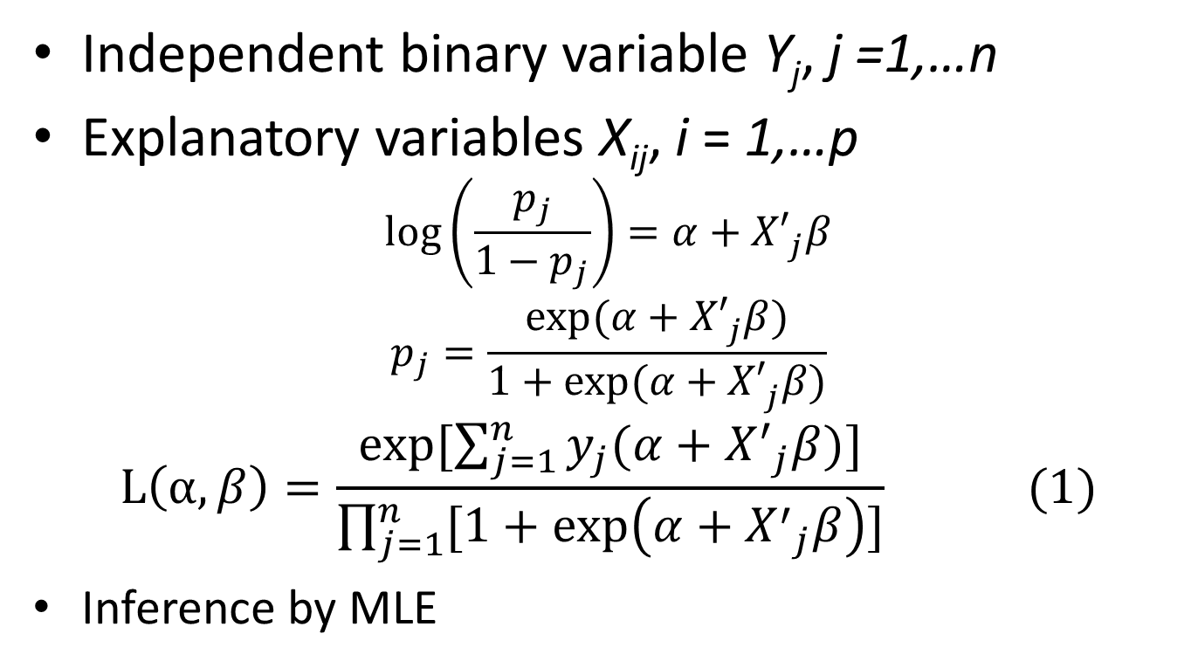
Logistic regression recap
Independent binary variable Y_{j}, j =1,…n
Explanatory variables X_{ij}, i = 1,…p
$$\log\left(\frac{p_{j}}{1−p_{j}}\right)=α+{X′}_{j}^{}β$$
$$p_{j}=\frac{exp⁡(α+{X′}_{j}^{}β)}{1+exp⁡(α+{X′}_{j}^{}β)}$$
$$L\left(α,β\right)=\frac{exp⁡[\sum_{j=1}^{n}{y_{j}(α+{X^{′}}_{j}^{}β)]}}{\prod_{j=1}^{n}{[1+\exp\left(α+{X^{′}}_{j}^{}β\right)]}} (1)$$
Inference by MLE

Slide 4
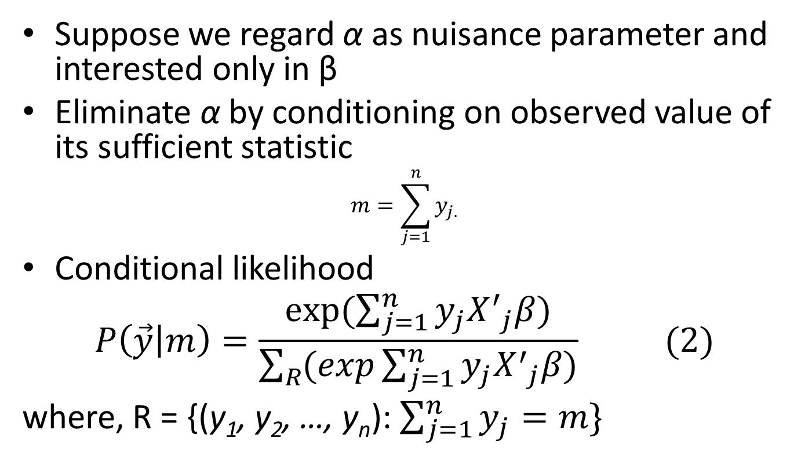
Conditional likelihood
Suppose we regard α as nuisance parameter and interested only in β
Eliminate α by conditioning on observed value of its sufficient statistic
$$m=\sum_{j=1}^{n}{y_{j.}}$$
Conditional likelihood
$$P\left(\vec{y} | m\right)=\frac{exp⁡(\sum_{j=1}^{n}{y_{j}{X^{′}}_{j}^{}β)}}{\sum_{R}{(exp\sum_{j=1}^{n}{y_{j}{X^{′}}_{j}^{}β)}}} (2)$$
where, R = {(y₁, y₂, …, y_{n}): $\sum_{j=1}^{n}{y_{j}=m\}}$

Slide 5
Conditional inference
Inference about β in two ways
  Exact (i.e exact logistic regression), based on permutation distribution of sufficient statistics
  Asymptotic (conditional logistic regression), based on maximizing the conditional likelihood (cMLE): analysis of matched or stratified data

Slide 6
Conditional logistic regression
Matched case-control study design
  Types of matching: one (1:1) or several (1:m) controls matched to each case
  Exposure variable recorded for cases and controls
Purpose of matching:
  Make cases and controls equal on known confounders
  Emphasize difference on exposure variable
  Commonly used matching variables: age, sex, location, time
Comparison within (not across) matched sets

Slide 7
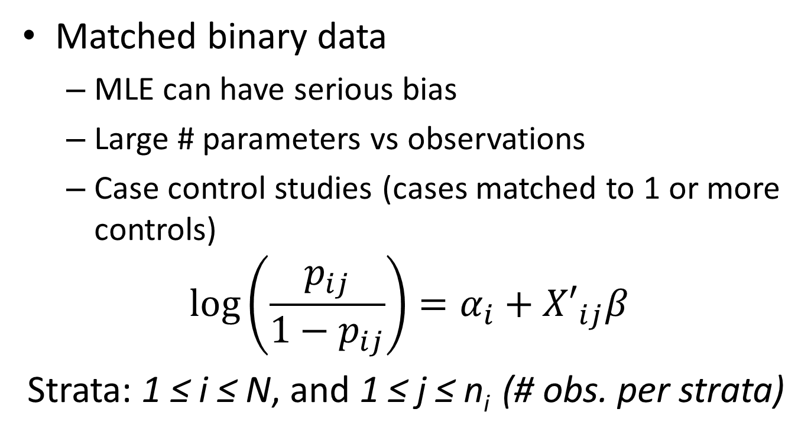
Conditional logistic…
Matched binary data
  MLE can have serious bias
  Large # parameters vs observations
  Case control studies (cases matched to 1 or more controls)
$$\log\left(\frac{p_{ij}}{1−p_{ij}}\right)=α_{i}+{X′}_{ij}β$$
Strata: 1 ≤ i ≤ N, and 1 ≤ j ≤ n_{i} (# obs. per strata)

Slide 8
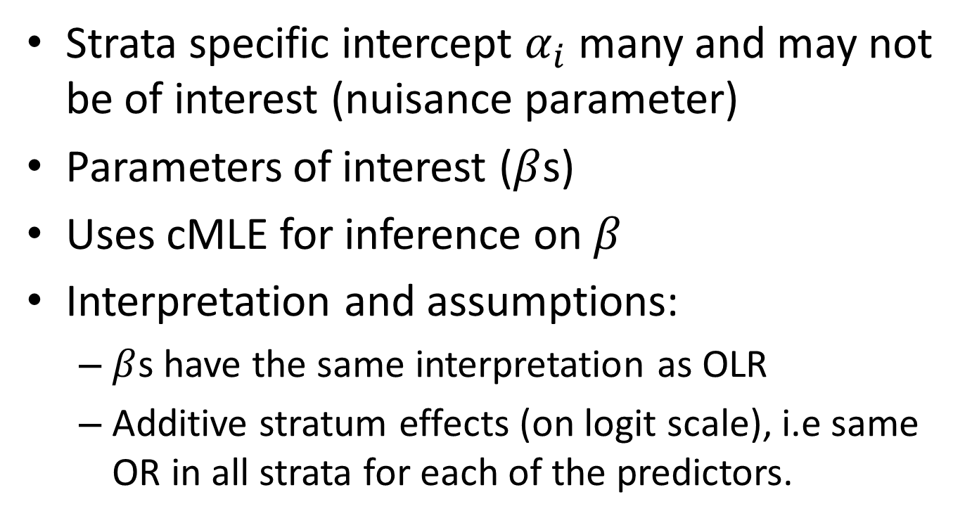
Conditional logistic …
Strata specific intercept $α_{i}$ many and may not be of interest (nuisance parameter)
Parameters of interest ($β$s)
Uses cMLE for inference on $β$
Interpretation and assumptions:
  $β$s have the same interpretation as OLR
  Additive stratum effects (on logit scale), i.e same OR in all strata for each of the predictors.

Slide 9
Example
Dataset SAL_OUTBRK (VER)
  Subset of real dataset from S. typhimurium outbreak (Denmark 1996)
  39 cases (diseased persons), 73 controls and 17 variables
  Matched for age, sex and residence (1-2 per case)
  Exposure variables obtained by interviews
Study aim
  Determine the source of Salmonella outbreak

Slide 10
Description of Data
Variable | Description | Values
match_grp | matched set id | nominal
casecontrol | case-control status | 0/1 (control/case)
age | age (years) | 2.53 - 64.44
gender | gender | 0/1 (male/female)
eatbeef | ate beef in prev. 72 hours | 0/1 (no/yes)
eatpork | ate pork in prev. 72 hours | 0/1 (no/yes)
eatpoul | age poultry in prev. 72 hours | 0/1 (no/yes)
eateggs | age eggs in prev. 72 hours | 0/1 (no/yes)
slt_a | ate pork from sl.house A | 0/1 (no/yes)
dlr_a | age pork from wholesaler A | 0/1 (no/yes)
… | … | …
Variable | eatpork |  | eatbeef |  | slt_a |  | dlr_a
Status | + | - | + | - | + | - | + | -
case | 1 | 0 | 0 | 1 | 1 | 0 | 0 | 1
control | 2 | 0 | 1 | 1 | 1 | 1 | 0 | 2
Sample data:
Matched set # 23

Slide 11
Simple descriptive methods for matched study design
Dichotomous (and categorical) exposure variable
  Mantel-Haenszel statistic (1:1 matching ~ McNemar’s test)
Continuous exposure variables
  Paired t-test or equivalent non-parametric test
  If 1:m matching use average among controls

Slide 12
Simple stratified analysis with STATA
Exposure variable (binary): slt_a
Matching group | OR [95% Conf. Interval]
-----------------+-------------------------------------------------
Crude | 3.214286 1.323847 7.940837
M-H combined | 3.866667 1.445059 10.34637
-------------------------------------------------------------------
Test of homogeneity (Tarone) chi2(38) = 36.13 Pr>chi2 = 0.5560
Test that combined OR = 1:
Mantel-Haenszel chi2(1) = 9.48
Pr>chi2 = 0.0021
M-H estimate cannot be generalized to data with many covariates, whereas conditional likelihood permits that.

Slide 13
Conditional logistic in STATA
Use clogit command
  clogit casecontrol slt_a, group(match_grp) or
Conditional (fixed-effects) logistic regression Number of obs = 112
LR chi2(1) = 10.00
Prob > chi2 = 0.0016
Log likelihood = -35.820042 Pseudo R2 = 0.1225
---------------------------------------------------------------------
casecontrol | Odds Ratio Std. Err. z P>|z| [95% Conf. Interval]
-------------+-------------------------------------------------------- slt_a | 4.415916 2.287893 2.87 0.004 1.59960 12.1907
----------------------------------------------------------------------------------------------------------------------------------------

Slide 14
Compare with OLR
.logit casecontrol slt_a, or
Logistic regression Number of obs = 112
LR chi2(1) = 8.27
Prob > chi2 = 0.0040
Log likelihood = -68.254443 Pseudo R2 = 0.0571
----------------------------------------------------------------------
casecontrol | Odds Ratio Std. Err. z P>|z| [95% Conf. Interval]
-------------+--------------------------------------------------------
slt_a | 3.214286 1.338167 2.80 0.005 1.421 7.268678
_cons | .2888889 .0909634 -3.94 0.000 .155 .5354903
----------------------------------------------------------------------
.clogit casecontrol slt_a, group(match_grp) or
Conditional (fixed-effects) logistic regression Number of obs = 112
LR chi2(1) = 10.00
Prob > chi2 = 0.0016
Log likelihood = -35.820042 Pseudo R2 = 0.1225
---------------------------------------------------------------------
casecontrol | Odds Ratio Std. Err. z P>|z| [95% Conf. Interval]
-------------+--------------------------------------------------------
slt_a | 4.415916 2.287893 2.87 0.004 1.59960 12.1907

Slide 15
Model building
Similar to OLS
  Perform univariable/bivariable analysis
  Identify important variables
  Build model using stepwise forward selection
Let us consider in the “sal_outbreak” data
  slt_a (P=0.004), dlr_a (P=0.02) and eateggs (P=0.17) are important
  Use stepwise forward selection for model building using these variables

Slide 16
Model building…
Add dlr_a to the original model with slt_a
Conditional (fixed-effects) logistic regression Number of obs = 83
LR chi2(2) = 14.80
Prob > chi2 = 0.0006
Log likelihood = -22.838098 Pseudo R2 = 0.2447
---------------------------------------------------------------------------
casecontrol | Odds Ratio Std. Err. z P>|z| [95% Conf. Interval]
-------------+-------------------------------------------------------------
slt_a | 4.355969 2.985271 2.15 0.032 1.136925 16.68929
dlr_a | 5.102542 5.628628 1.48 0.140 .5872511 44.33527
---------------------------------------------------------------------------
Try adding interaction effect
Here the two variables are highly collinear, so we omit
Decide whether dlr_a should stay or not
Add the third variable and so on…, until you have a final model
In our case, slt_a remains as the only predictor

Slide 17
Model Diagnostics
Model evaluation by residuals/diagnostics (CLR specific)
  With predict (STATA 13)
  With clfit (add on)

